Slide 1



14 December 2020
Laura Salamero Teixidó, PhD
Administrative Law Lecturer
University of Lleida

Slide 2
Food waste and COVID-19
AGENDA:
The relevance of food waste: an economic, social and environmental problem
¿Who, when and why?
The European Union and its approach to food waste
The Spanish legal framework: quick overview
Food waste and COVID-19: some thoughts
Conclusions: new opportunities

Slide 3
1. The relevance of food waste (I)
Source: FAO http://www.fao.org/3/a-c0088e.pdf
Desagregated data: http://www.fao.org/food-loss-and-food-waste/flw-data/en/

Slide 4
1. The relevance of food waste (II)
Economic dimension
Social/human dimension
Environmental dimension

Slide 5
1. The relevance of food waste: economic dimension (III)
In Europe 88 million tones of food waste are generated annually with associated costs estimated at 143 billion Euros
This estimate is for 2012 and includes both edible food and inedible parts associated with food. This equates to 173 kilograms of food waste per person in the EU-28.
Source: FUSIONS, Estimates of European food waste level, 2016

Slide 6
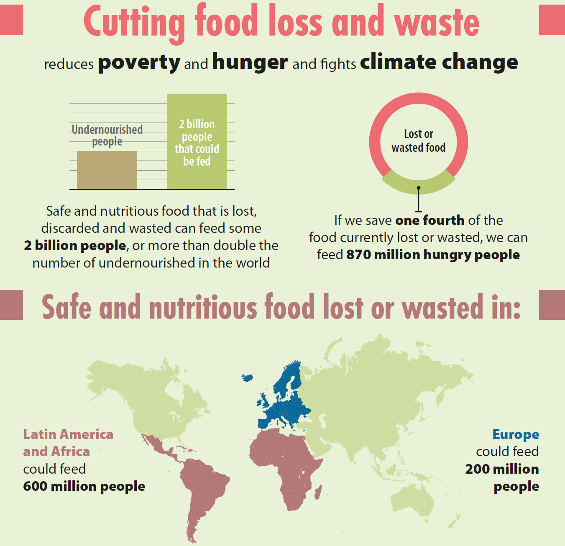
1. The relevance of food waste: social dimension (IV)
The “food paradox”:
While 1/3 of the world food’s production is lost or wasted, more than 820 million people live in a situation of food insecurity

Slide 7
1. The relevance of food waste: environmental dimension (V)
Use of natural resources: water, land, sea resources, biodiversity
GHG emissions
Contaminants: pesticides, etc.
Waste production: packaging, organic waste...
IPCC, Climate Change and Land. An IPCC Special Report on climate change, desertification, land degradation, sustainable land management, food security, and greenhouse gas fluxes in terrestrial ecosystems. Summary for Policy Makers. Approved Draft, 2019.
FAO, Food wastage footprint, Impacts on Natural resources, Summary report, 2013.

Slide 8
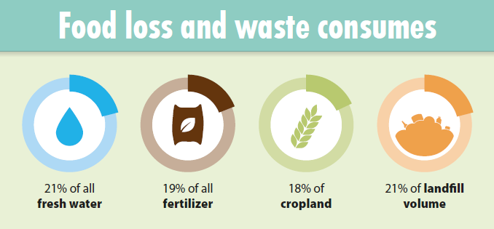

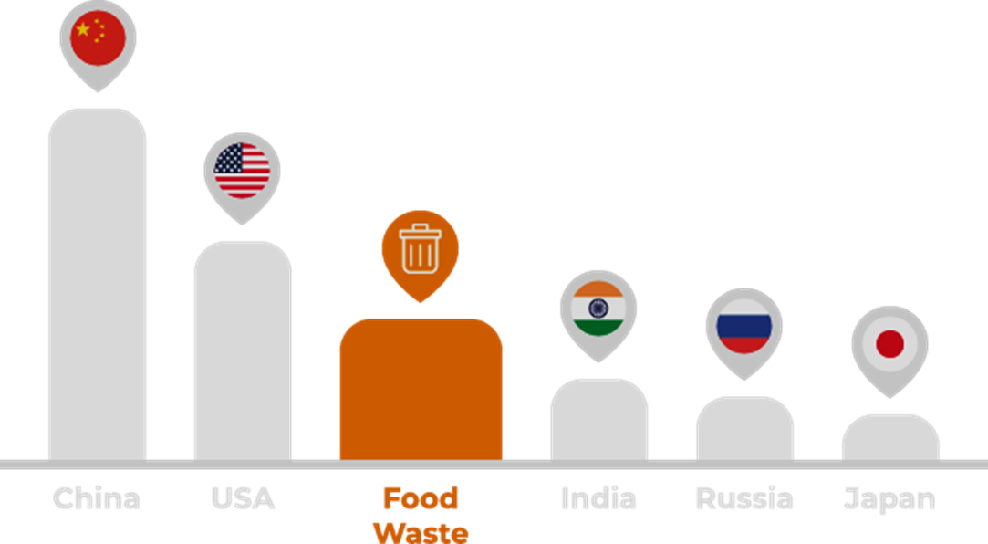
Land use
Landfills from food waste occupy 3 times the surface of the EU.
Green House Gases

Slide 9
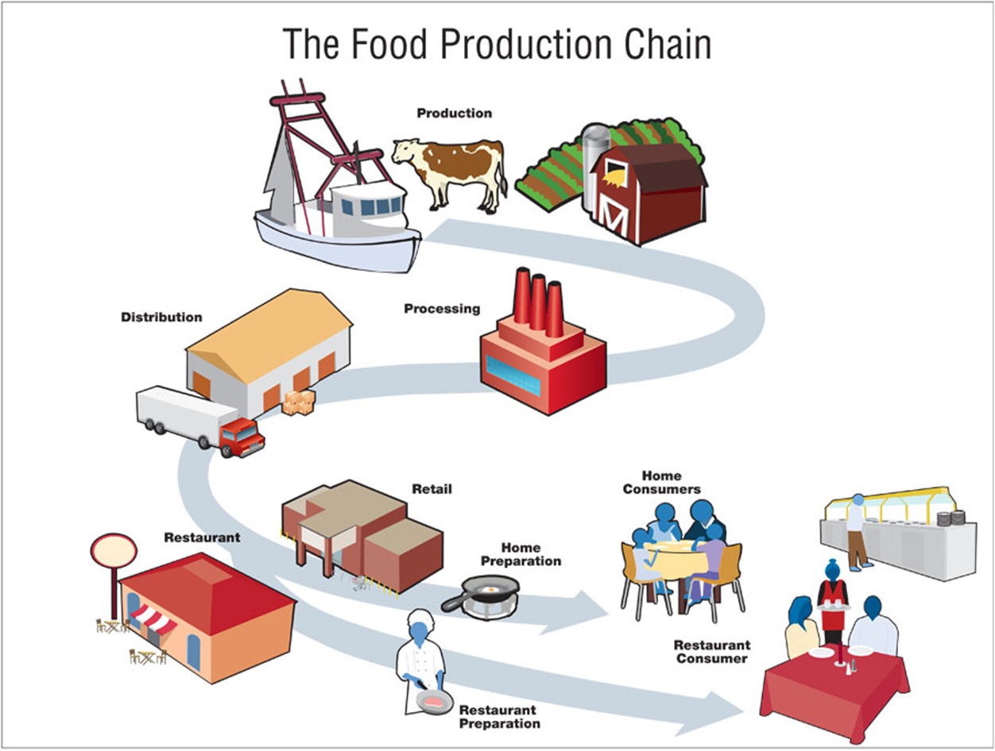
2. Who, when and why? (I)

Slide 10
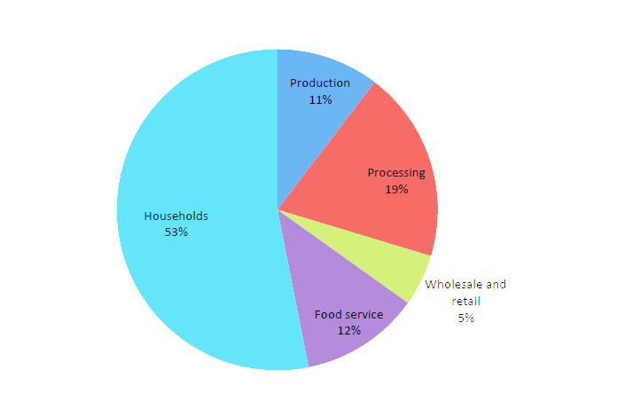
2. Who, when and why? (II)
Fuente: FUSIONS, Estimates of European food waste level, 2016
Notes:
Diferencia entre países desarrollados y en vías de desarrollo
Datos se pueden desagregar más (Agencia de Residus Catalunya, Informe de 2012). Pero el consumidor final sigue siendo el que más desperdicia. Los datos varían en la distribuión grandes superficies, superficies menor tamaño, mercados, etc.

Slide 11
2. Who, when and why? (III)
Fuente: FUSIONS, Estimates of European food waste level, 2016
Notes:
Diferencia entre países desarrollados y en vías de desarrollo
Datos se pueden desagregar más (Agencia de Residus Catalunya, Informe de 2012). Pero el consumidor final sigue siendo el que más desperdicia. Los datos varían en la distribuión grandes superficies, superficies menor tamaño, mercados, etc.

Slide 12
2. Who, when and why? (IV)
Production – Primary sector
  Surplus
  Technical conditions, R+D+I
  Disconformity with “quality standards”
  Storage conditions
Transformation/Processing
  Technical conditions
  R+D+I
Transportation
  Technical conditions
  R+D+I
Wholesale and retail
  Stocks – Offer/Demand
  Packaging
  Loose foods
  Marketing strategies (buy 2 get 1 free; full stacks)
  Disconformity with “quality standards”
Food services
  Big portions
Final consumers/Households
  Lack of awareness
  Lack of planning
  Lack of knowledge (cooking abilities, leftovers, etc.)
  Best before vs. use by
  Cultural factors

Slide 13
1+2. To sum up
Food waste is a relevant problem, with social, economic and environmental consequences
It is a complex problem, to which a wide number of causes and subjects contribute along the whole food chain
It is part of the international and national agenda
  Italy, France, USA, among others
  UN, FAO, EU

Slide 14
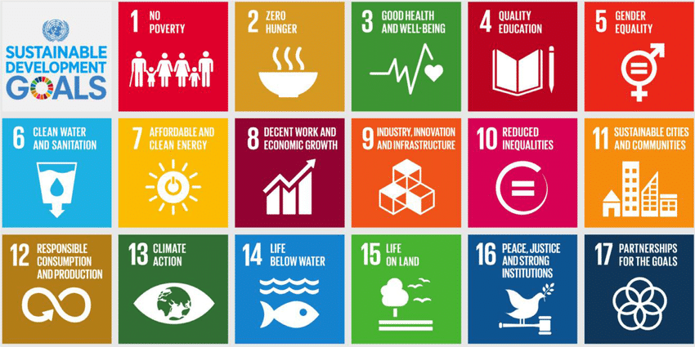
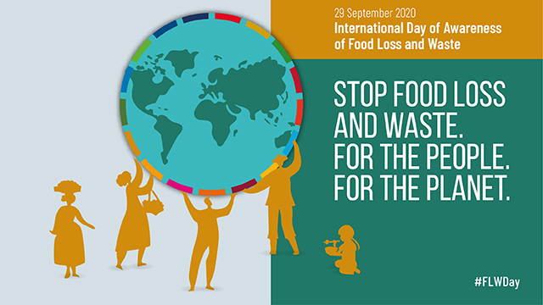
SDG nº 12: Ensure sustainable consumption and production patterns
Target 12.3: By 2030, halve per capita global food waste at the retail and consumer levels and reduce food losses along production and supply chains, including post-harvest losses.

Slide 15
3. The European Union and its approach (I)
A long path, still being walked:
FUSIONS Project (Food Use for Social Innovation by Optimising Waste Prevention Strategies), research project established by the EC between 2012 and 2016.
First Circular Economy Plan, launched in 2015.
Refresh Project (Resource Efficient Food and dRink for the Entire Supply Chain), research project established between 2015 and 2019 within the H2020 Framework Program
EU Platform on Food Losses and Food Waste (FLW) was established in 2016, bringing together EU institutions, experts from the EU countries and relevant stakeholders selected through an open call for applications. The Platform aims to support all actors in: defining measures needed to prevent food waste; sharing best practice; and evaluating progress made over time.
European Commisson and European Parliament, with a number of guidelines and resolutions relating to food loss and waste.
Circular Economy Package 2018 → The amendment of the Waste Framework Directive (WFD)→ landmark in the process
European Green Deal + A new Circular Economy Action Plan for a Cleaner and More Competitive Europe (2020) + Farm to fork strategy (2020)

Slide 16
3. The European Union and its approach (II)
Goal
  Contribution to the achievement of SDG 12.3 (Responsible Consumption and Production): By 2030, halve per capita global food waste at the retail and consumer levels and reduce food losses along production and supply chains, including post-harvest losses.
  It sets its own target for the EU: to achieve a 30% reduction by 2025, before reaching 50% in 2030 (recitals)
Keys to the new regulations on food waste:
  Introduction of a new concept of "food waste"
  Application of the waste hierarchy to food waste
  Incorporation of specific obligations for MS
The environmental approach to food waste (vs. nutritional approach)

Slide 17
3. The European Union and its approach (III)
A new legal concept: “food waste”
First legal definition (art. 3.4.a WFD) + Delegated Decision (EU) 2019/1597 of 3 May 2019
“Waste” + “food”: WFD + General Food Law
Broad concept (includes inedible parts, old foods, etc.), with exclusions (animal subproducts, sacrificed animals for sanitary reasons, etc.)
  Pre-harvest losses are not included (because they are not considered to be “food”) → gleaning
Food waste vs. bio-waste: “biodegradable garden and park waste, food and kitchen waste from households, offices, restaurants, wholesale, canteens, caterers and retail premises and comparable waste from food processing plants”
  Food waste generated in the first phases of the food chain is excluded from the concept of bio-waste: primary production, transportation, distribution, etc.
  Dichotomy: two regimes
    Food waste: concept
    Bio-waste: waste flow

Slide 18
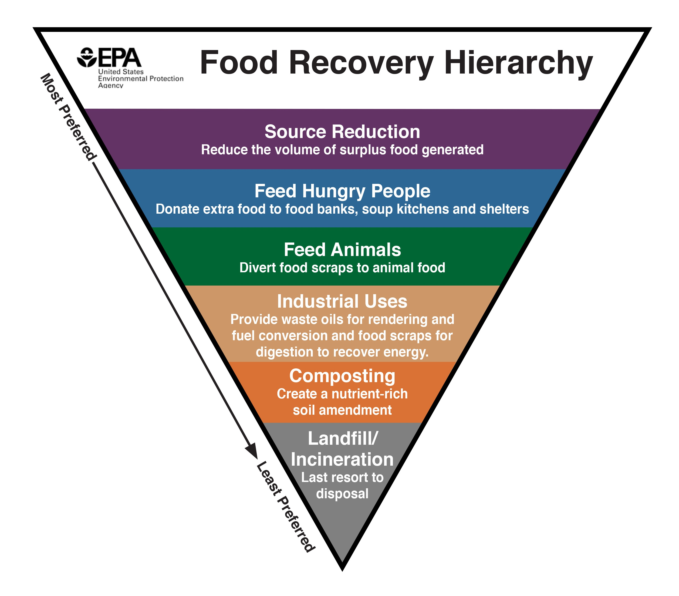
3. The European Union and its approach (IV)
The waste hierarchy applies to food waste (art. 4 WFD: “a) prevention; b) preparing for re-use; c) recycling; d) other recovery, e.g., energy recovery; and e) disposal”)
Criticism: specific hierarchy for food waste
  Like in France, USA, Catalonia, etc.
It does not prevent the hierarchy to be applied to food waste
  Prevention: donation (art. 9.1.h WFD)
  Prevention: Annex IV.a, 3: fiscal incentives for donation of products, in particular food

Slide 19
3. The European Union and its approach (V): Obligations of the Member States
1. Food waste PREVENTION
  Low intensity and non concretion obligation
  Art. 9.1.g): “reduce the generation of food waste in primary production, in processing and manufacturing, in retail and other distribution of food, in restaurants and food services as well as in households as a contribution...” to SDG nº 12.3
  Art. 9.1.h): donation and other distribution strategies + Annex IV tax incentives to donation
  Art. 29.2.bis: national programs specific to food waste prevention (→ “Más alimento, menos desperdicio” Strategy in Spain)
2. MEASUREMENT and ACCOUNTABILITY
  Art. 9.5 and 9.6: obligation to monitor and assess the effectiveness of the measures implemented
  Common measurement methodology: Delegated decision (EU) 2019/1597 + disaggregated by phases
  Obligation to inform the European Commission (EC) on the results + in the light of the data the EC shall stablish, if feasible, a reduction goal for the MS for 2030 + the EC shall submit a legislative proposal, if appropriate

Slide 20
3. The European Union and its approach (VI): Obligations of the Member States
3. BIO-WASTE MANAGEMENT obligations
  Bio-waste → more restrictive concept than “food waste”
  Art. 22: “Member States shall ensure that (…) bio-waste is either separated and recycled at source, or is collected separately and is not mixed with other types of waste”
  Member States shall take measures “to encourage recycling, including composting and digestion (…); home composting; and promote the use of materials produced from bio-waste”
  Implementation by 31 December 2023

Slide 21
4. The Spanish framework (I)
“Más alimento, menos desperdicio” Strategy
Spanish Circular Economy Strategy
  Reduction of food waste as “strategic orientation” to elaborate action plans.
  2020 target: reduce food waste generation along the food chain: 50% reduction at the household and wholesale levels + 20% production and distribution by 2020 → as a contribution to the SDG → a play to the gallery
The Spanish parliamentary forces have failed in several occasions to pass a national law on the matter
Waste and Contaminated Soils draft bill
  Several provisions on food waste + bio-waste → transposition WFD
  Special emphasis on prevention (art. 19)
    Waste hierarchy applied to food waste
    Food donation : liability social entities + pay-as-you-throw/tax incentives for donation social entities
Spanish Autonomous Communities (decentralized State)
  Catalonia: Llei 3/2020, d’11 de març, de prevenció de les pèrdues i del malbaratament d’aliments

Slide 22
5. Food waste and COVID-19: What has been the impact of COVID-19 on the generation of food waste?
Acknowledgement of the limitations
  Lack of data
  Shift in priorities
Impact of COVID-19 along the food chain
  The impact differs depending on the food product (luxury products)
  The impact differs depending on the phase of the chain (commercial/hospitality sector)
  The impact differs depending on degree of digitalization, client diversification, etc.
Impact of COVID-19 on consumption (and eating) habits
  Hoarding and stockpiling
  Food safety concerns in connection with COVID-19
Impact of COVID-19 on economic and social terms
  Negative impact on household’s income
  Increase of vulnerability and food insecurity situations
  Assistance institutions, like food banks, increase their activity

Slide 23
5. Food waste and COVID-19: Can any lessons be learned?
Proposals in relation to the food chain
  Make the food chain logistics less complex → More decentralized food chain including small producers
  Make the food chain shorter → shorter food supply chain → encourage local consumption
  More flexibility and resilience along the chain → EC Contingency Plan for ensuring food supply and food security in case of crisis
Proposals in relation to consumption (and dietary) habits
  More education and awareness are needed
Proposals to alleviate vulnerability and food insecurity situations
  Strengthen food donation strategies

Slide 24
5. Food waste and COVID-19: new opportunities?
The WFD as a robust pillar → sustainable development + circular economy + European Grean Deal + F2F
  Transposition of the WFD → opportunity
The waste hierarchy as the key instrument
  Focus on prevention strategies
    Modernization of the food chain: digitalization, blockchain
    Transformation of the food chain: km0
    Redistribution of surplus: food recovery companies, mobile apps, etc.
    New creative ways to foster donation: liability, fiscal incentives, others
  Re-use, recycling, recovery
The whole food chain has to be involved
Social entities like food banks as part of the food chain

Slide 25
Thank you for your attention
Laura Salamero Teixidó, PhD
Administrative Law Lecturer
University of Lleida
laura.salamero@udl.cat

